Slide 1


Project Name Cable Insights Initiative
Presenter Name
Business Insights Team

Slide 2
Playbook Contents
Project Overview
National Inside Sales Insights
Field Sales Insights
Open Q & A
Appendix
Confidential | Decisions on Demand Training Playbook

Slide 3
Project Overview
As we role into 2019 the Business Insights team has developed an initiative to analyze SBE Cable Performance for 2018. This analysis will provide channel stakeholders with:
Challenges Surrounding Sales
What is currently working
Opportunities for the immediate future
Recommendations for a future state
Confidential | Presentation Title

Slide 4
National Inside Sales Insights
Channel Overview
Summary statistics for count of 41 Brampton NIS and 60 Toronto NIS reps*.
Toronto NIS contributes majority of cable units, however the average number of cable units sold per rep is relatively the same at 17 units between channels.*
Ramp-up progresses positively up until May where cable sales teetered off afterwards and has held relatively stagnant for June and July
Unit count for reps are as follows:
Rep Target Achievement
Jan – Aug 2018
Toronto | Product | Jan | Feb | Mar | Apr | May | Jun | Jul | Aug | Avg.
 | Cable | 5 | 6 | 8 | 17 | 22 | 17 | 17 | 18 | 14
 | Wireless | 21 | 15 | 47 | 23 | 30 | 26 | 22 | 20 | 26
 | P&S | 24 | 23 | 32 | 30 | 22 | 21 | 25 | 22 | 25
 | All Three | 3 | 0 | 5 | 9 | 9 | 8 | 4 | 6 | 6
Cable Units Achieved | Number of Reps
0 – 10 | 28
11 - 20 | 27
21 – 30 | 27
31+ | 22
Brampton | Product | Jan | Feb | Mar | Apr | May | Jun | Jul | Aug | Avg.
 | Cable | 22 | 14 | 13 | 21 | 27 | 17 | 14 | 7 | 17
 | Wireless | 20 | 20 | 35 | 28 | 28 | 26 | 19 | 13 | 24
 | P&S | 34 | 27 | 31 | 31 | 33 | 26 | 20 | 15 | 27
 | All Three | 8 | 4 | 11 | 11 | 17 | 9 | 4 | 2 | 8
NIS Outbound | NIS | Jan | Feb | Mar | Apr | May | Jun | Jul | Aug | Avg.
 | Cable | 27 | 20 | 21 | 38 | 49 | 34 | 31 | 25 | 31
 | Wireless | 41 | 35 | 82 | 51 | 58 | 52 | 41 | 33 | 49
 | P&S | 58 | 50 | 63 | 61 | 55 | 47 | 45 | 37 | 52
 | All Three | 11 | 4 | 16 | 20 | 26 | 17 | 8 | 8 | 14
*Does not include data from Elliot / Ryan
Notes:
Toronto reps who have hit target in all three bucket avg 14
Brampton reps who have hit target in all three bucket avg 17
If we take a look at Outbound NIS in its entirety only 31 reps have hit their target, 31% of the salesforce
Ryan and Elliot excluded

Slide 5
National Inside Sales Insights
Channel Overview
Summary statistics for count of 41 Brampton NIS and 60 Toronto NIS reps*.
Toronto NIS contributes majority of cable units, however the average number of cable units sold per rep is relatively the same at 17 units between channels.*
Ramp-up progresses positively up until May where cable sales teetered off afterwards and has held relatively stagnant for June and July
Unit count for reps are as follows:
Rep. Target Achievement
Jan – Aug 2018
Toronto | Product | Jan | Feb | Mar | Apr | May | Jun | Jul | Aug | Avg.
 | Cable | 5 | 6 | 8 | 17 | 22 | 17 | 17 | 18 | 14
 | Wireless | 21 | 15 | 47 | 23 | 30 | 26 | 22 | 20 | 26
 | P&S | 24 | 23 | 32 | 30 | 22 | 21 | 25 | 22 | 25
 | All Three | 3 | 0 | 5 | 9 | 9 | 8 | 4 | 6 | 6
Toronto
Sum of Units Sold | 1301
Avg. Units Sold per Rep | 22.65
Brampton*
Sum of Units Sold | 826
Avg. Units Sold per Rep | 19.7
Brampton | Product | Jan | Feb | Mar | Apr | May | Jun | Jul | Aug | Avg.
 | Cable | 22 | 14 | 13 | 21 | 27 | 17 | 14 | 7 | 17
 | Wireless | 20 | 20 | 35 | 28 | 28 | 26 | 19 | 13 | 24
 | P&S | 34 | 27 | 31 | 31 | 33 | 26 | 20 | 15 | 27
 | All Three | 8 | 4 | 11 | 11 | 17 | 9 | 4 | 2 | 8
Channel Target Achievement
Product Sold | Avg. per Rep per Month
Internet | 17
Television | 16
Phone | 17
NIS Outbound | NIS | Jan | Feb | Mar | Apr | May | Jun | Jul | Aug | Avg.
 | Cable | 27 | 20 | 21 | 38 | 49 | 34 | 31 | 25 | 31
 | Wireless | 41 | 35 | 82 | 51 | 58 | 52 | 41 | 33 | 49
 | P&S | 58 | 50 | 63 | 61 | 55 | 47 | 45 | 37 | 52
 | All Three | 11 | 4 | 16 | 20 | 26 | 17 | 8 | 8 | 14
*Does not include data from Elliot / Ryan

Slide 6
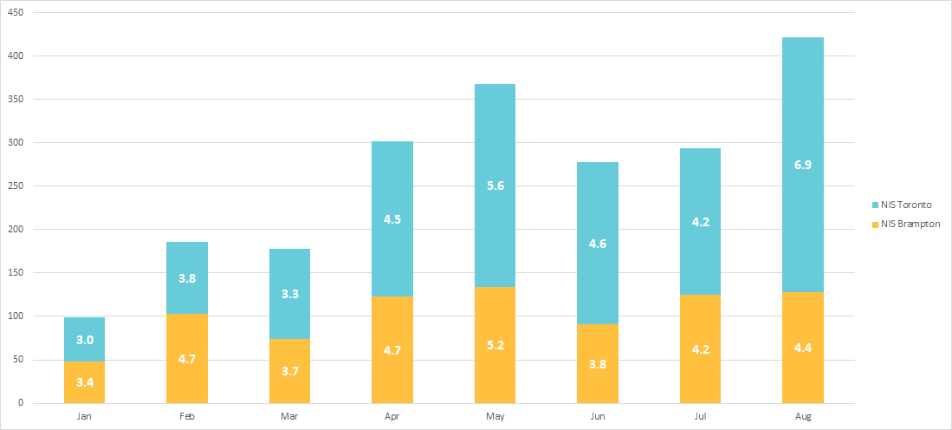
National Inside Sales Insights
Average Cable Units by Rep*
Units
Confidential | Presentation Title
*Does not include data from Elliot / Ryan

Slide 7
NIS Manager Perspective
Success / Challenges
What is working?
Product repricing and adding TV
Cable upsell campaigns
New Prospecting Techniques
What are the Challenges?
Confidence in Marketing Campaign
Number of Campaigns available to Sales Associates
Locating servable locations is very time consuming
Large product learning curve for most Sales Associates
Knowledge sharing around techniques, tips and best practises amongst the sales channel
Efficiency with Internal Tools ie. MapNet / SGI / SFDC
SFDC Usage
Contract End Dates – flush out
Confidential | Presentation Title

Slide 8
Recommendations
New NIS Cable Rep Workforce
Dedicate three NIS Outbound teams that focus more towards achieving Cable targets.
Details:
Workforce should consist of 32 NIS Associates (to actualize 2018 Cable target)*
Associates will have a 60 Cable / 20 Wireless / 20 BPS - target split
Manage Prospects / Opportunities accounts outside of Field Territories
Challenges:
Creating feasible quota targets and compensation development
Interaction with Field Sales associates and business conflicts
Sales Associates identification for new workforce
Remaining Sales Associates roles and responsibilities
Gains:
Sustainable amount of businesses to ensure Sales Associate Success
Lower attrition of Sales Associates
Great flexibility around Campaign development and distribution
Higher Productivity
Based on 2018 Cable Targets

Slide 9
Field Sales Insights
FSA – TSR Enquiry
Summary statistic for cable penetration within FSA
Grand total of FSA sits at 45.3% penetration rate with a combined 111,396 units of Rogers serviced cable products
Top 25 FSAs are at 33.5% penetration rate with a combined 2,357 units of Rogers serviced cable products
FSAs assigned to Field agents are at 44.6% penetration rate with a combined 89,839 units of Rogers serviced cable products
Grand total of serviceable units for in FSA at 245,913 while 201,267 81.84% of those are assigned to a Field agent within TSR model
High penetration rates within FSA may be contributing to reps prospecting outside cable campaign / lead lists
Annual quota for cable units for Toronto NIS and Brampton are 3,351 and 2,648 respectively; given current combined total units achievement in quota would require a 3.0% increase to market penetration within assigned FSA.
Assigned
Sum | 201,267
Penetrated
Sum | 89,839
Opportunities
Sum | 111428
Ave Per Agent | 2786
Manager | Sum of Serviceable | Sum of TV | TV Penetration | Sum of Internet | Internet Penetration | Sum of Phone | Phone Penetration | Combined Penetration | Penetration | Sum of Opportunities
Andrew Osborne | 26641 | 3444 | 13% | 8890 | 33% | 6671 | 25% | 11450 | 43.0% | 15191
Anthony Kalam | 20223 | 2771 | 14% | 7074 | 35% | 5224 | 26% | 9580 | 47.4% | 10643
David Silva | 32855 | 4396 | 13% | 13095 | 40% | 9570 | 29% | 16184 | 49.3% | 16671
Jason Giff | 48112 | 6623 | 14% | 14396 | 30% | 10343 | 21% | 20068 | 41.7% | 28044
Kyle McHenry | 30349 | 4023 | 13% | 10091 | 33% | 6434 | 21% | 13605 | 44.8% | 16744
Roman Semionov | 21261 | 2494 | 12% | 6683 | 31% | 4981 | 23% | 8798 | 41.4% | 12463
Wesley Zapitelli | 21826 | 2539 | 12% | 8037 | 37% | 5490 | 25% | 10154 | 46.5% | 11672
Grand Total | 201267 | 26290 | 13% | 68266 | 34% | 48713 | 24% | 89839 | 44.6% | 111428
Notes - 3.0% increase in market penetration = 0.446-((3351+2648+89839)/201267)
Notes:
2.1% increase in market penetration= 245913/(111,396+3351+2648)
Grand total of serviceable units for in FSA at 245,913 while 201,267 81.84% of those are assigned to a Field agent within TSR model
High penetration rates within FSA may be contributing to reps prospecting outside cable campaign / lead lists
Annual quota for cable units for Toronto NIS and Brampton are 3,351 and 2,648 respectively; given current combined total units achievement in quota would require a 3.0% increase to market penetration within non-assigned FSA.

Slide 10
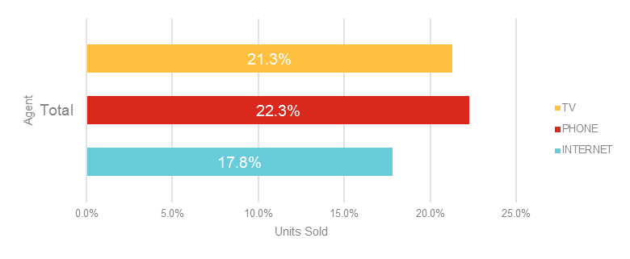
Field Cable Ramp Analysis
Territory Contribution - Overview
Summary statistics for count of 36 Field Sales agents
61% of agents sell under the average contribution within their respective FSA territory
No mode, no value appears more often than others
Only one agent - Craig Colin sells less than 10% outside designated territory
One agent – Daniel O’Leary contributes nothing to assigned territory
(are they hitting targets)
Higher percentage of units sold in assigned FSA territory correlates with lower number of units sold
Moderate negative correlation coefficient of -0.45
Field channel and NIS Outbound accounts for 33% and 10% of total sales within TSR respectively
Mean
26.1%
Median
17.0%
Acquisition within Field owned FSA –Jan – July
Acquisition Within Agent Owned FSA
Channel | Internet | Phone | TV | Grand Total
3rd Party | 5% | 11% | 2% | 18%
Field | 11% | 17% | 5% | 33%
NIS Brampton | 2% | 3% | 1% | 6%
NIS Inbound | 19% | 18% | 3% | 39%
NIS Toronto | 2% | 2% | 1% | 4%
Grand Total | 39% | 50% | 11% | 100%
Notes:
This slide shows an overview of our findings, we took a count of 36 agents, crunched the numbers, and came back with some note worthy stats:
- Similar spread of line of products sold
- Important thing to note is the average contribution which is 27.5% within the assigned territory which means most units are sold outside a designated territory
- Only one rep sells less than ten percent outside designated territory which is the benchmark
- What’s this says to me is the TSR model isn’t being followed and when we dig deeper we find that as field agents sell more within their territory they actually sell less

Slide 11
Recommendations
New Field Sales Territory Model
Considering most sales are made outside of an Field Associates territory a deep dive into a new coverage model is required.
Action Plan:
Complete Deep Data Analysis in-progress (Refer to Opportunity Based Selling Workbook)
Present Recommendation to Stakeholders
Possibly move to Postal Code based selling (instead of FSA based)
Align strategically to the Address Based Selling and fibre acquisition goals for 2019
Confidential | Presentation Title
Mid-Market Integration Exploration (deep dive into what’s on the horizon and how to future proof upcoming changes
New NIS Cable distribution Model (select group of reps and or team mainly focused on cable sales) 2019 may include fibre and cable. (30 NIS Cable Reps and add additional Field Sales rep)
Field Sales Territory deep Analysis and Model Revamp

Slide 12
Recommendations
Business Insight Opportunities
Due to the lack of confidence in Marketing provided campaigns, we have an opportunity to supplement these campaigns with our own lists.
Action Plan:
Complete a gap analysis around what our team could supplement the sales floor
Alternative lead generation through automated web scraping
Connect with relevant stakeholders on proposal for buy-in
Training Opportunities:
Get the ball rolling on formal MapNet training for Sales Associates
Identify a Subject Matter Expert for product knowledge and tool usage
Confidential | Presentation Title
Mid-Market Integration Exploration (deep dive into what’s on the horizon and how to future proof upcoming changes
New NIS Cable distribution Model (select group of reps and or team mainly focused on cable sales) 2019 may include fibre and cable. (30 NIS Cable Reps and add additional Field Sales rep)
Field Sales Territory deep Analysis and Model Revamp

Slide 13
Requirements
SFDC Usage Standardization
With the implementation of Inside Sales, we have a great opportunity to streamline and standardize SFDC Usage. This will grant us the opportunity to:
Capture consistent data points to drive sound decision making activities
Refine sales coverage models
Stronger productivity for Sales Agents
In-depth Reporting Capabilities
Greater Coaching Opportunities for Management
Confidential | Presentation Title

